Slide 1
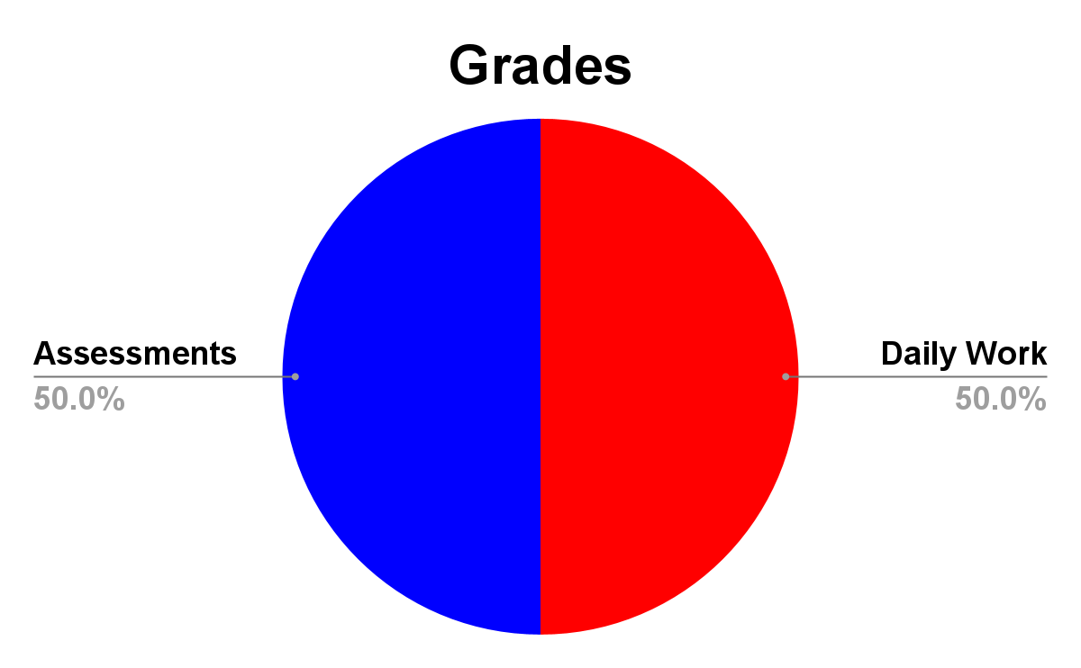
8th
Social Studies
Grade
2024 – 2025
Mr. Mills
GRADES
alan.mills@usd497.org
Make sure to keep up with your grade on PowerSchool, as it is updated often!
Participation is the KEY
Social Studies is, by nature, a class in which there should be talking and discussion. I encourage students to speak up, ask and answer questions, and present their thoughts about the topics we are exploring.
Work:
Students will be learning the following skills this year:
American History:
Colonial America, Revolution, Founding Documents, Early America, Growing Republic, Westward Expansion, Civil War, Reconstruction
CLASS MATERIALS
iPad
Library book
Headphones
Spiral Notebook
Pencils/Pens
Highlighters
**PLEASE bring everything on this list to class every day!
**HOMEWORK: IF you stay focused IN CLASS and STUDENT SUCCESS to complete the assignments given, you will rarely have homework.

Slide 2
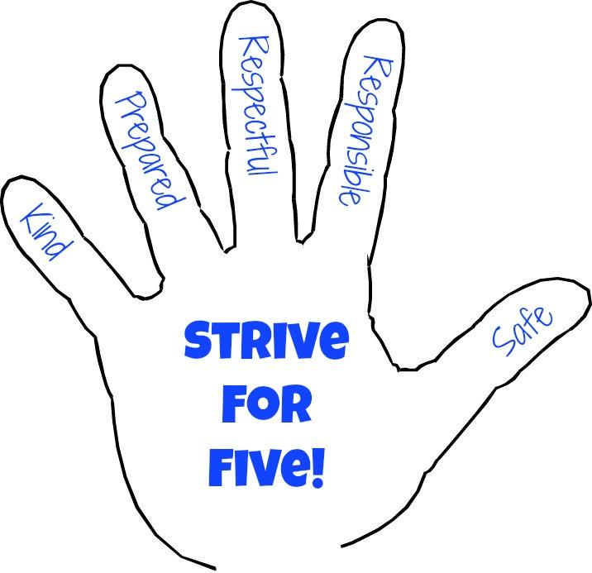
In Class Procedures
Please arrive on time!
Find your seat before the Bell
iPads closed
Fill out your planner
Mindfulness
Be an active participant
EXPECTATIONS
What I Expect of You | What You Can Expect of Me
I expect you to be kind to everyone. | I will be kind to everyone. I may have to be firm, but I will not be unkind.
I expect you to come to class prepared. We all have bad days, and I do not expect perfection, but this is school and you will need to be ready to roll! | I will have the classroom and the lesson prepared. Agenda on the board Materials prepared Lesson ready
I expect you to be respectful of all people and property. | I will be respectful toward all people and property.
I expect you to be responsible about your work. Homework, unless otherwise explained, is due the next day. | I will be responsible and get your work graded and returned to you in a timely manner.
I expect you to look out for the safety of yourself and those around you, physical and otherwise. | I will look out for the safety of everyone in my class and on my team.
GOOGLE
CLASSROOM
Since you are in Middle School, it is imperative that you check Google Classroom every day. It is where all work will be posted. Here are a few tips:
Look for announcements and discussions in the STREAM.
For assignments, head to the CLASSWORK section.
When you finish an assignment, you must press the TURN IN button. I can’t grade it if you don’t turn it in!
iPads
You will all have an iPad assigned to you for school use. Please be sure to take good care of your iPad and charge it each night. You are expected to use it appropriately at all times. Failure to do this will result in contact with your parents and an office referral.

